Slide 1
IAS Machine

Slide 2
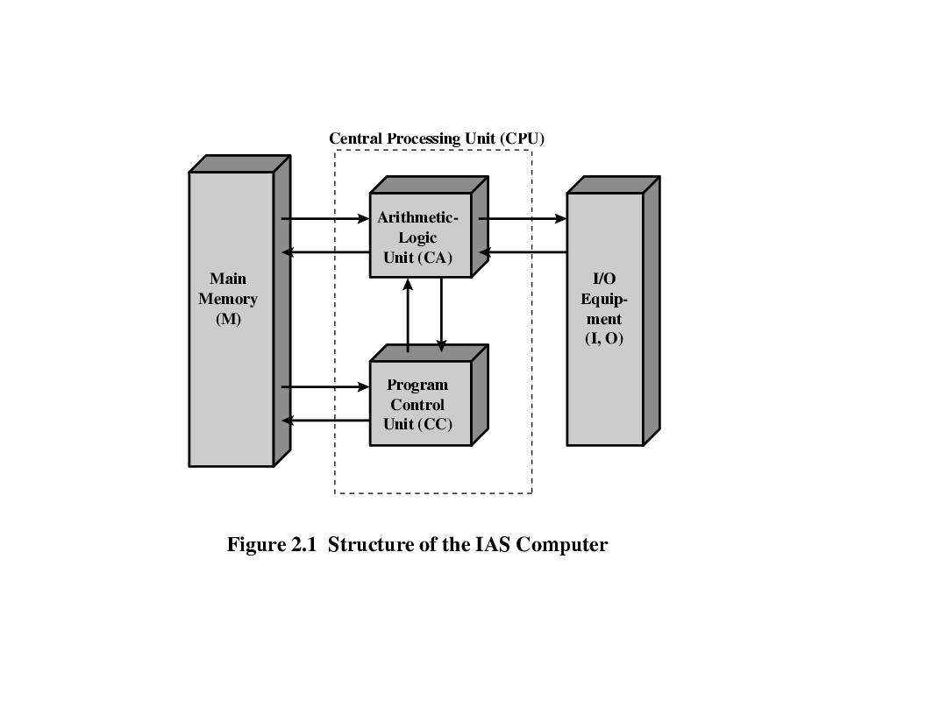
Organization of the von Neumann machine
IAS – a prototype developed by John Von Neumann in 1946 at Princeton
University. (Institute for Advanced Study)
Structure of Von Neumann machine(IAS Computer)
Notes:
IAS: Institute for Advanced Studies.

Slide 3
IAS – memory format
1000 x 40 bit words ( 1000 storage locations of 40 binary bits each)
Binary number( both data and instructions are stored here)
Number Format:
Each number is represented by a sign bit and a 39 bit value.
Instruction Format:
A word may contain 20 bit instruction with each instruction consisting of an 8 bit operation code (opcode) specifying the operation to be performed and a 12 bit address designating one of the words in memory (0 to 999)

Slide 4
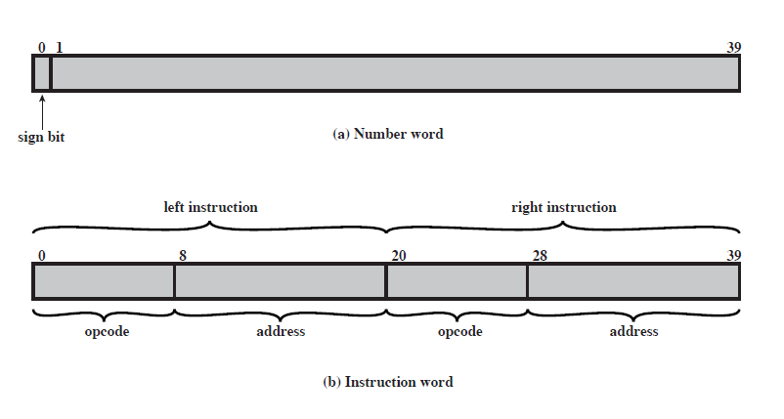
IAS – Contd..
Memory Formats
1000 x 40 bit words ( 1000 storage locations of 40 binary bits each)
Binary number( both data and instructions are stored here)
Number Format
Each number is represented by a sign bit and a 39 bit value.
Instruction Format
- 20-bit instruction, 8-bit operation code (opcode)
-12-bit address

Slide 5
IAS – Contd..
IAS – Total 21 Instructions
Data Transfer
Unconditional Branch Instruction
Conditional Branch Instruction
Arithmetic
Address Modify Instruction

Slide 6
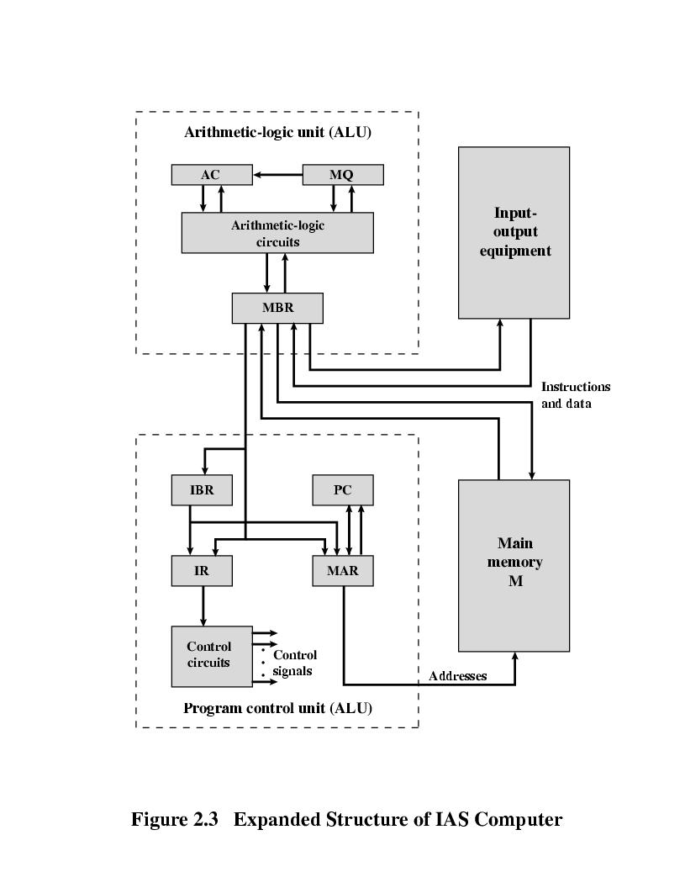
Expanded Structure of IAS

Slide 7
Expanded structure of IAS computer
Set of registers (storage in CPU)
Memory Buffer Register (MBR)
Contains a word to be stored in memory or sent to the I/O unit, or it is used to receive a word from memory or from the I/O unit.
Memory Address Register (MAR)
Specifies the address in memory of the word to be written from or read into the MBR.
Instruction Register (IR)
Contains the 8 bit opcode instruction being executed.
Instruction Buffer Register (IBR)
Employed to hold temporarily the right hand instruction from a word in memory
Program Counter (PC)
Contains the address of the next instruction pair to be fetched from memory
Accumulator (AC) & Multiplier Quotient (MQ)
Employed to hold temporarily the right hand instruction from a word in memory. For eg. The result of multiplying two 40 bit numbers is an 80 bit number, the most significant 40 bits are stored in the AC and the least significant in the MQ.

Slide 8
IAS Operation - Flowchart
AC
MQ
Input/output
Equipments
MAR←PC
No
Is next instruction in IBR?
MBR←M[MAR]
Arithmetic & Logic Circuits
IBR←MBR<20..39>
IR←MBR<0..7>
MAR←MBR<8..19>
yes
MBR
MBR←M[MAR]
AC←MBR
IR←IBR<0..7>
MAR←IBR<8..19>
IBR
PC
Main Memory
PC←PC+1
PC←MAR
MBR←M[MAR]
IR
MAR
AC← MBR
Control
Circuits

Slide 9

AC = 7
AC = 3
MEMORY
1. LOAD M(X) 500, ADD M(X) 501
2. STOR M(X) 500, (Other Ins)
.....
3
4
AC
MQ
500
MBR = 4
LOAD M(X)
MBR
MBR = 3
500
ADD M(X) 501
(Other Ins)
STOR M(X)
PC
1
2
MAR
1
500
501
2
500
MBR
LOAD M(X) 500, ADD M(X) 501
3
4
STOR M(X) 500, (Other Ins)
IR
LOAD M(X)
ADD M(X)
STOR M(X)
IBR
ADD M(X) 501
(Other Ins)
AC
3
501
PC = 2
7
IBR
PC = 1
Add M(X)
Mar ← PC
MAR ←PC
3
LOAD M(X) 500, ADD M(X) 501
4
IR
MAR = 2
STOR M(X) 500, (Other Ins)
MAR = 501
MAR = 1
MAR = 500
MAR =500
add = 501
add = 1
add = 500
add = 2

Slide 10
Register transfer operation for addition operation
1. LOAD M(X) 500, ADD M(X) 501
Register transfer operations: (PC = 1)
MAR ← PC
MBR ← M[MAR]
IBR ← MBR[20:39]
IR ← MBR[0:7]
MAR ← MBR[8:19]
MBR ← M[MAR]
AC ← MBR
IR ← IBR[0:7]
MAR ← IBR[8:19]
MBR ← M[MAR]
AC ← AC + MBR

Slide 11
Fetch / Execute Cycle

Slide 12
AC = 7
AC = 3
MEMORY
1. LOAD M(X) 500, ADD M(X) 501
2. STOR M(X) 500, (Other Ins)
.....
3
4
AC
MQ
500
MBR = 4
LOAD M(X)
MBR
MBR = 3
500
ADD M(X) 501
(Other Ins)
STOR M(X)
PC
1
2
MAR
1
500
501
2
500
MBR
LOAD M(X) 500, ADD M(X) 501
3
4
STOR M(X) 500, (Other Ins)
IR
LOAD M(X)
ADD M(X)
STOR M(X)
IBR
ADD M(X) 501
(Other Ins)
AC
3
501
PC = 2
7
IBR
PC = 1
Add M(X)
Mar ← PC
MAR ←PC
3
LOAD M(X) 500, ADD M(X) 501
4
IR
MAR = 2
STOR M(X) 500, (Other Ins)
MAR = 501
MAR = 1
MAR = 500
MAR =500
add = 501
add = 1
add = 500
add = 2

Slide 13
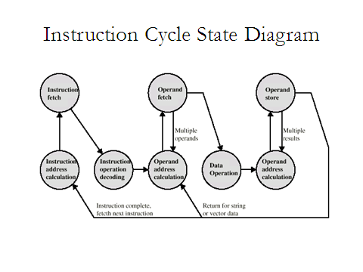
Notes:
Note: This is an instruction cycle state diagram without interrupts

Slide 14
Instruction set: Collection of instructions that the CPU can execute
What an Instruction set should specify?
Which Operation to perform (Opcode)
Where to find the operand or operands (CPU registers, main memory or I/O port)
Where to put the result, if there is result
Where to find the next instruction

Slide 15
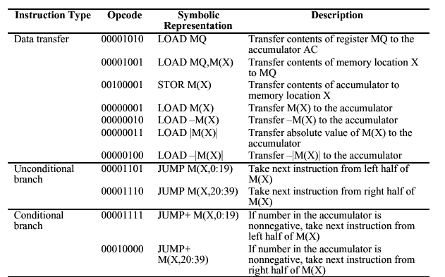
IAS Instruction set

Slide 16
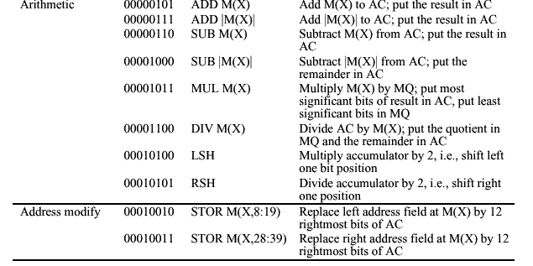
IAS Instruction set Contd..

Slide 17
Instruction Format
The instruction is divided into two fields
Opcode field
Operand field
This operand field further divided into one to four fields.
Simple instruction format
Opcode
Operand
Address1
Operand
Address2
Result
Address1
Next
Instruction

Slide 18
Instruction Set is categorized into types based on
Operation performed
number of operand addresses
and addressing modes
Based on Operation
Data Movement
Memory : LOAD, STORE, MOV I\O Instructions: IN, OUT
Data Processing
Arithmetic : Add, Sub, MUL Logic Instructions: AND, OR,
Control Instructions
Conditional : JNZ, JZ Un Conditional: Jump

Slide 19
Based on number of operand address in the instruction.
4 Address Instruction
3 Address Instruction
2 Address Instruction
1 Address Instruction
0 Address Instruction
For a two-operand arithmetic instruction, five items need to be specified
Operation to be performed (opcode)
Location of the first operand
Location of the second operand
Place to store the result
Location of next instruction to be executed

Slide 20
Assumptions 24-bit memory address (3 bytes) 128 instructions (7 bits rounded to 1 byte)

Slide 21
4- Address Instruction
Memory
24 Bits / 3 Bytes
8
24
24
24
24
Op Code
ResAddr
Op1Addr
Op2Addr
NextiAddr
Op Code
ResAddr
Op1Addr
Op2Addr
NextiAddr
CPU
Op1
Example: add M1,M2,M3, nexti
M(1)←M(2)+M(3)
Op2
+
Memory Required to store an Instruction:
5 x 3 bytes = 15 Bytes
Resop
Memory Required to Encode an Instruction:
1Byte+ 4 x 3 bytes = 13 Bytes
Calculation of Memory Accesses
To fetch Instruction itself
To Execute an Instruction
Opcode=1
Op1Addr=1
Op1=1
Op2Addr=1
Op2=1
ResAddr=1
Res=1
NextiAddr=1
Total=3
Total=5
Total Memory Traffic= No. of M/A to fetch + No. of M/A to Execute
Total Memory Traffic= 5 + 3 =8

Slide 22
3- Address Instruction
Memory
24 Bits / 3 Bytes
8
24
24
24
Op Code
ResAddr
Op1Addr
Op2Addr
Op Code
ResAddr
Op1Addr
Op2Addr
CPU
Op1
Example: add M1,M2,M3
M(1)←M(2)+M(3)
Op2
+
Memory Required to store an Instruction:
4 x 3 bytes = 12 Bytes
Resop
Memory Required to Encode an Instruction:
1Byte+ 3 x 3 bytes = 10 Bytes
PC
24
Calculation of Memory Accesses
To fetch Instruction itself
To Execute an Instruction
Opcode=1
Op1Addr=1
Op1=1
Op2Addr=1
Op2=1
ResAddr=1
Res=1
Total=4
Total=3
Total Memory Traffic= No. of M/A to fetch + No. of M/A to Execute
Total Memory Traffic= 4+ 3 =7

Slide 23
2- Address Instruction
Memory
24 Bits / 3 Bytes
8
24
24
24
Op Code
Op1Addr
Op2Addr
CPU
Op Code
Op1Addr
Op2Addr
Example: add M2,M3
M(2)←M(2)+M(3)
Op1
Op2
+
Memory Required to store an Instruction:
3 x 3 bytes = 09 Bytes
Resop
Memory Required to Encode an Instruction:
1Byte+ 2 x 3 bytes = 7 Bytes
PC
24
Calculation of Memory Accesses
To fetch Instruction itself
To Execute an Instruction
Opcode=1
Op1Addr=1
Op1=1
Op2Addr=1
Op2=1
Res=1
Total=3
Total=3
Total Memory Traffic= No. of M/A to fetch + No. of M/A to Execute
Total Memory Traffic= 3+ 3 =6

Slide 24
1- Address Instruction
Memory
24 Bits / 3 Bytes
8
24
24
Op Code
Op1Addr
CPU
Op Code
Op1Addr
Op1
Example: add M2
Op2
+
Memory Required to store an Instruction:
2 x 3 bytes = 06 Bytes
Resop
Acc
Memory Required to Encode an Instruction:
1Byte+ 1 x 3 bytes = 4Bytes
PC
24
Calculation of Memory Accesses
To fetch Instruction itself
To Execute an Instruction
Opcode=1
Op1Addr=1
Op1=1
Total=2
Total=1
Total Memory Traffic= No. of M/A to fetch + No. of M/A to Execute
Total Memory Traffic= 2+ 1 =3

Slide 25
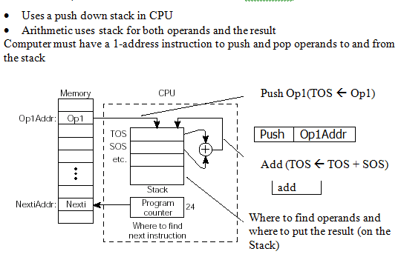
0-Address Instruction

Slide 26
Comparisons
Instruction Type | Memory To Store in Bytes | Memory To Encode in Bytes | M/As to fetch an Instruction | M/As to Execute an Instruction | Memory Traffic
4-address | 5 x 3 = 15 | 1+(4 x 3) = 13 | 5 | 3 | 5+3=8
3-Address | 4 x 3 = 12 | 1+(3 x 3) = 10 | 4 | 3 | 4+3=7
2-Address | 3 x 3 = 09 | 1+(2 x 3) = 07 | 3 | 3 | 3+3=6
1-Address | 2 x 3 = 06 | 1+(1 x 3) = 04 | 2 | 1 | 2+1=3
0-Address | 1 x 3 = 03 | 1+(0 x 3) = 01 | 1 | 0 | 1+0=1

Slide 27
Evaluate a = (b+c)*d - e
3-Address
add a, b, c
a←b+c
0-Address
mpy a, a, d
a←a*d
push b
sub a, a, e
a←a-e
push c
2-Address
add
load a, b
a←b
push d
add a, c
a←a+c
mpy
mpy a, d
a←a*d
push e
sub a, e
a←a-e
1-Address
sub
load b
Acc←b
pop a
add c
Acc←Acc+c
mpy d
Acc←Acc*d
sub e
Acc←Acc-e
store a
a←Acc

Slide 28
Memory to Store | Memory to encode | M/As to Fetch | M/As to Execute | Memory Traffic
4*3=12 | 1+(3*3)=10 | 4 | 3 | 4+3=7
4*3=12 | 1+(3*3)=10 | 4 | 3 | 4+3=7
4*3=12 | 1+(3*3)=10 | 4 | 3 | 4+3=7
36 | 30 | 12 | 9 | 21
add a, b, c
a←b+c
mpy a, a, d
a←a*d
sub a, a, e
a←a-e
Memory to Store | Memory to encode | M/As to Fetch | M/As to Execute | Memory Traffic
3*3=9 | 1+(2*3)=7 | 3 | 2 | 3+2=5
3*3=9 | 1+(2*3)=7 | 3 | 3 | 3+3=6
3*3=9 | 1+(2*3)=7 | 3 | 3 | 3+3=6
3*3=9 | 1+(2*3)=7 | 3 | 3 | 3+3=6
36 | 28 | 12 | 11 | 23
load a, b
a←b
add a, c
a←a+c
mpy a, d
a←a*d
sub a, e
a←a-e

Slide 29
Memory to Store | Memory to encode | M/As to Fetch | M/As to Execute | Memory Traffic
2*3=6 | 1+(1*3)=4 | 2 | 1 | 2+1=3
2*3=6 | 1+(1*3)=4 | 2 | 1 | 2+1=3
2*3=6 | 1+(1*3)=4 | 2 | 1 | 2+1=3
2*3=6 | 1+(1*3)=4 | 2 | 1 | 2+1=3
2*3=6 | 1+(1*3)=4 | 2 | 1 | 2+1=3
30 | 20 | 10 | 5 | 15
load b
Acc←b
add c
Acc←Acc+c
mpy d
Acc←Acc*d
sub e
Acc←Acc-e
store a
a←Acc
push b
6 | 4 | 2 | 1 | 3
3 | 1 | 1 | 0 | 1
39 | 23 | 13 | 5 | 18
push c
add
push d
mpy
push e
sub
pop a

Slide 30
Evaluate X=(A+B) * (C+D)
Evaluate Y=(A-B)/[C+(D/E)]

Slide 31
References
Reference Book
W. Stallings, Computer organization and architecture, Prentice-Hall,2000
J. P. Hayes, Computer system architecture, McGraw Hill,2000
Vincent .P. Heuring, Harry F. Jordan “ Computer System design and Architecture” Pearson, 2nd Edition, 2003

